Slide 1



Pizza DashBoard
View in Power BI
Last data refresh:
9/17/2024 3:23:28 PM UTC
Downloaded at:
9/17/2024 4:39:38 PM UTC

Slide 2
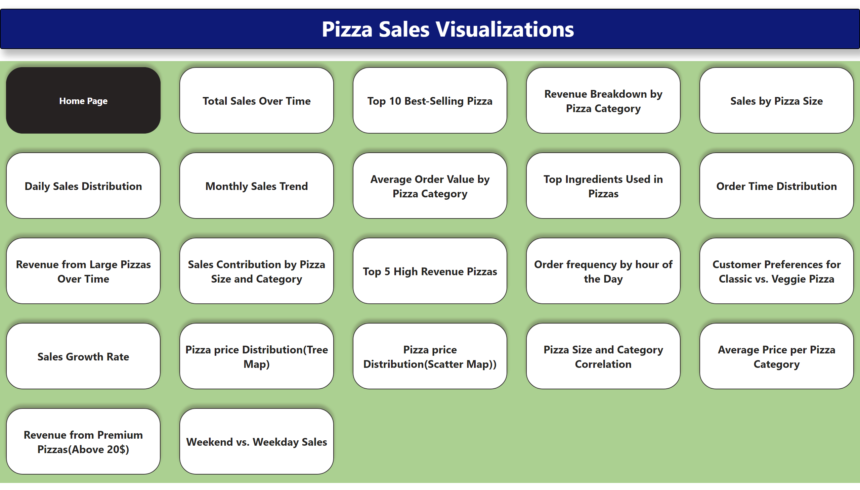
Home Page
Notes:
textbox
No alt text provided
pageNavigator
No alt text provided
textbox
No alt text provided

Slide 3
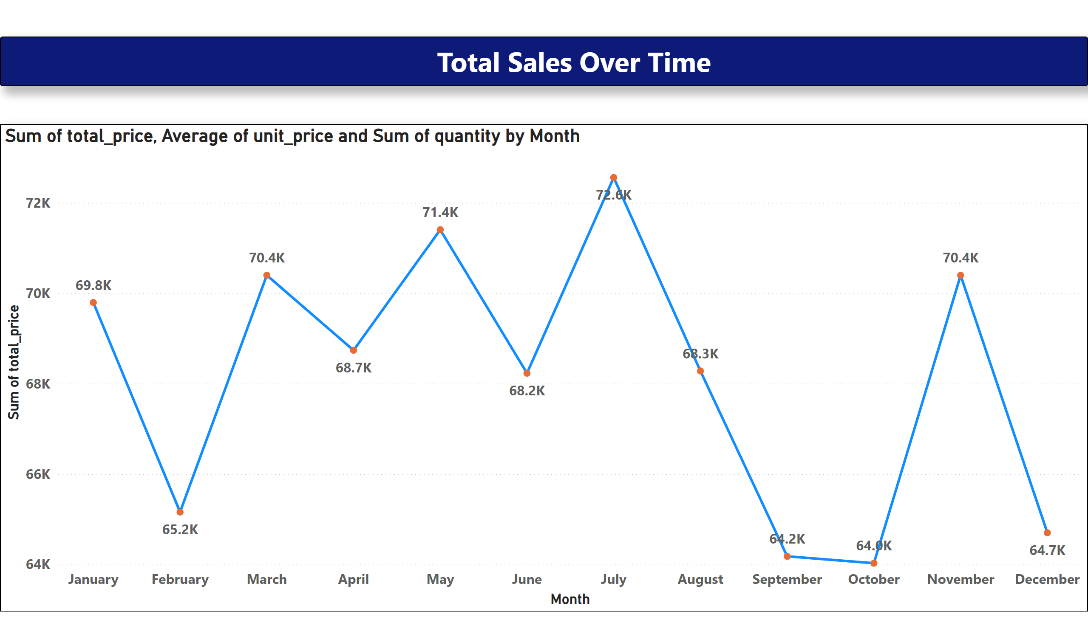
Total Sales Over Time
Notes:
textbox
No alt text provided
lineChart
No alt text provided

Slide 4
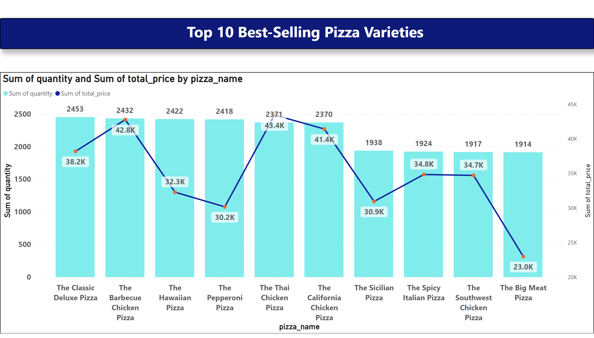
Top 10 Best-Selling Pizza
Notes:
textbox
No alt text provided
lineStackedColumnComboChart
No alt text provided

Slide 5
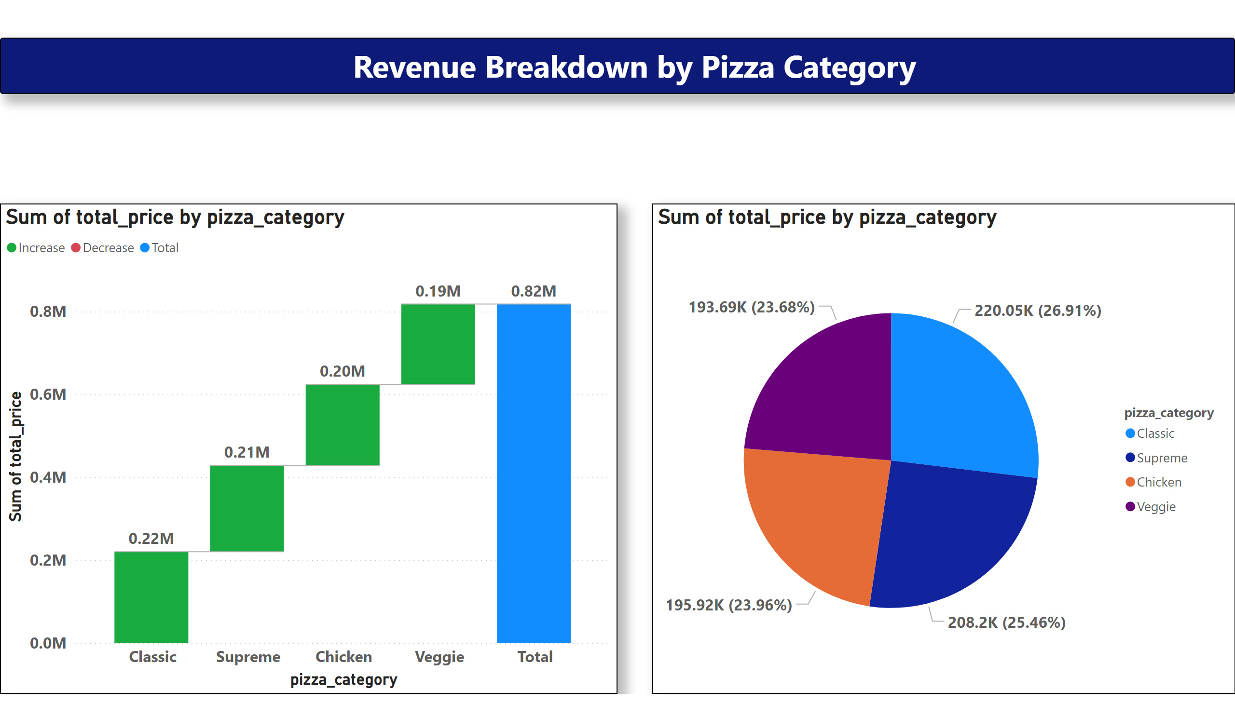
Revenue Breakdown by Pizza Category
Notes:
textbox
No alt text provided
waterfallChart
No alt text provided
pieChart
No alt text provided

Slide 6
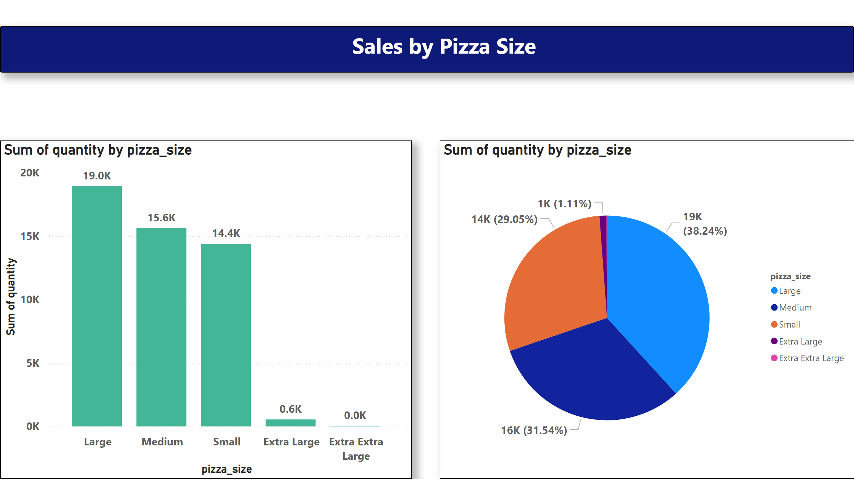
Sales by Pizza Size
Notes:
textbox
No alt text provided
columnChart
No alt text provided
pieChart
No alt text provided

Slide 7
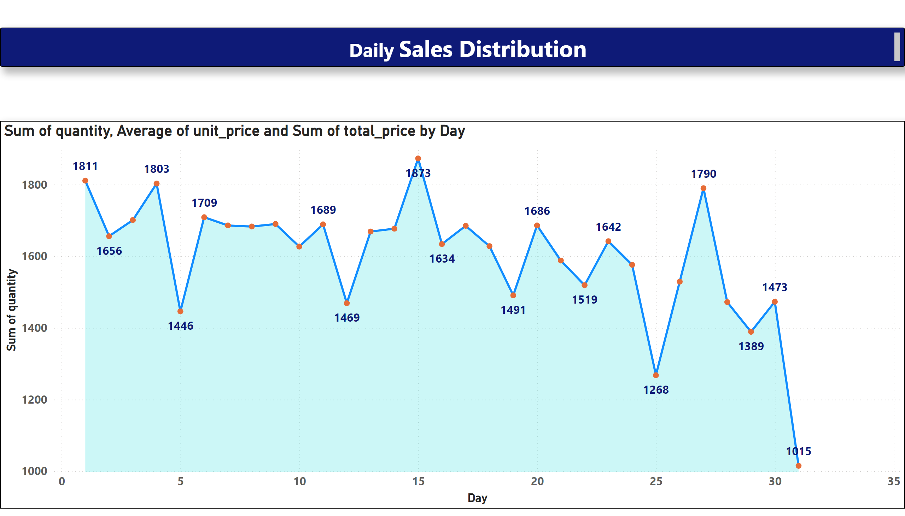
Daily Sales Distribution
Notes:
textbox
No alt text provided
areaChart
No alt text provided

Slide 8
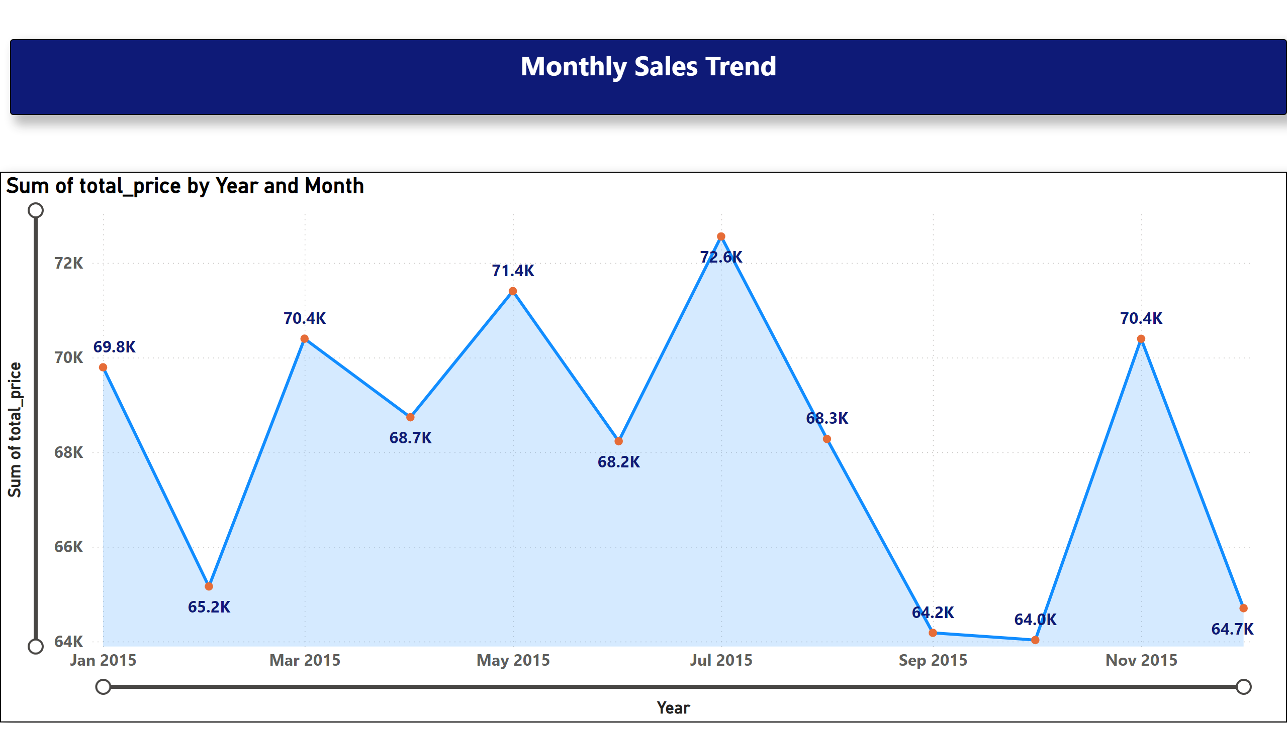
Monthly Sales Trend
Notes:
textbox
No alt text provided
lineChart
No alt text provided

Slide 9
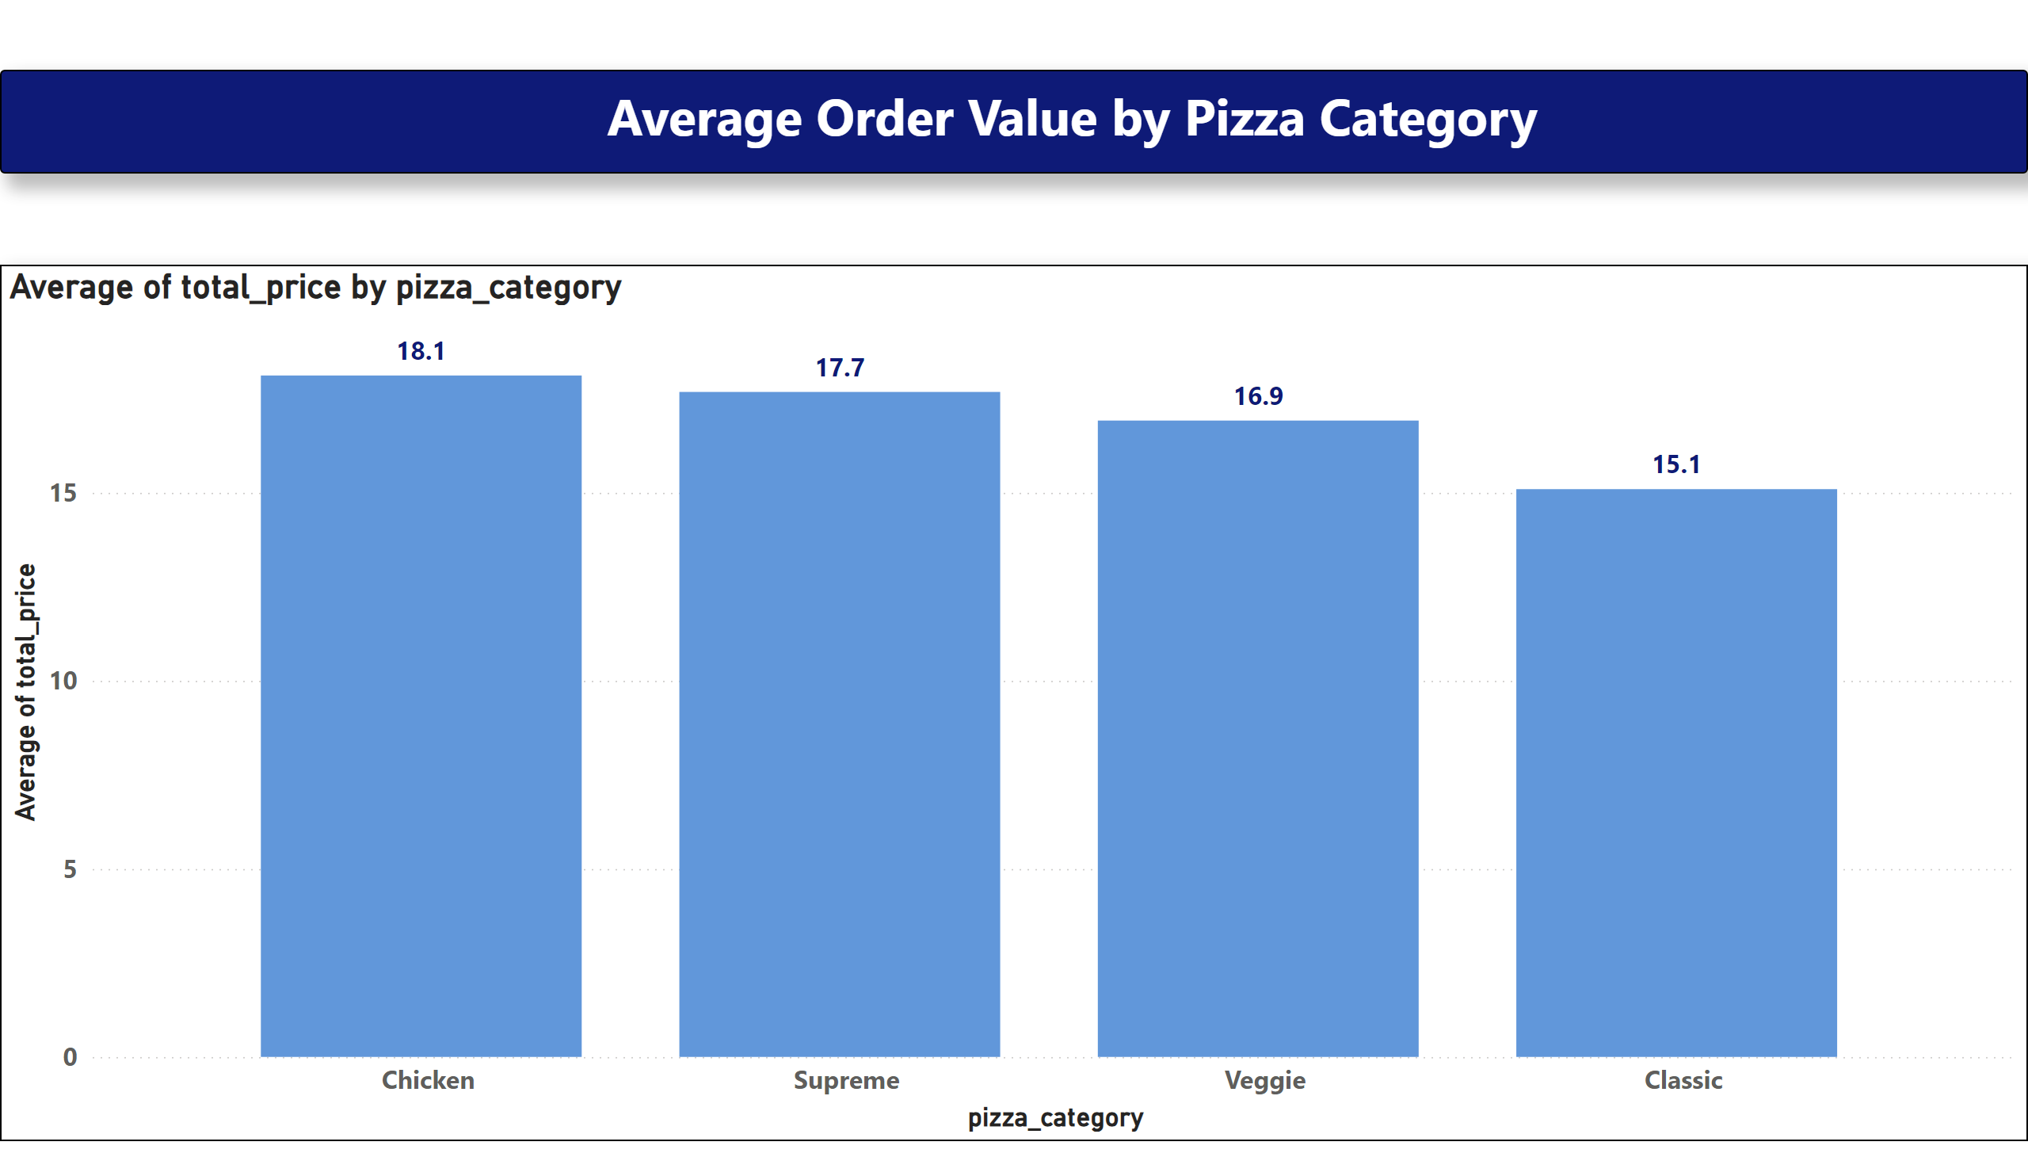
Average Order Value by Pizza Category
Notes:
textbox
No alt text provided
columnChart
No alt text provided

Slide 10
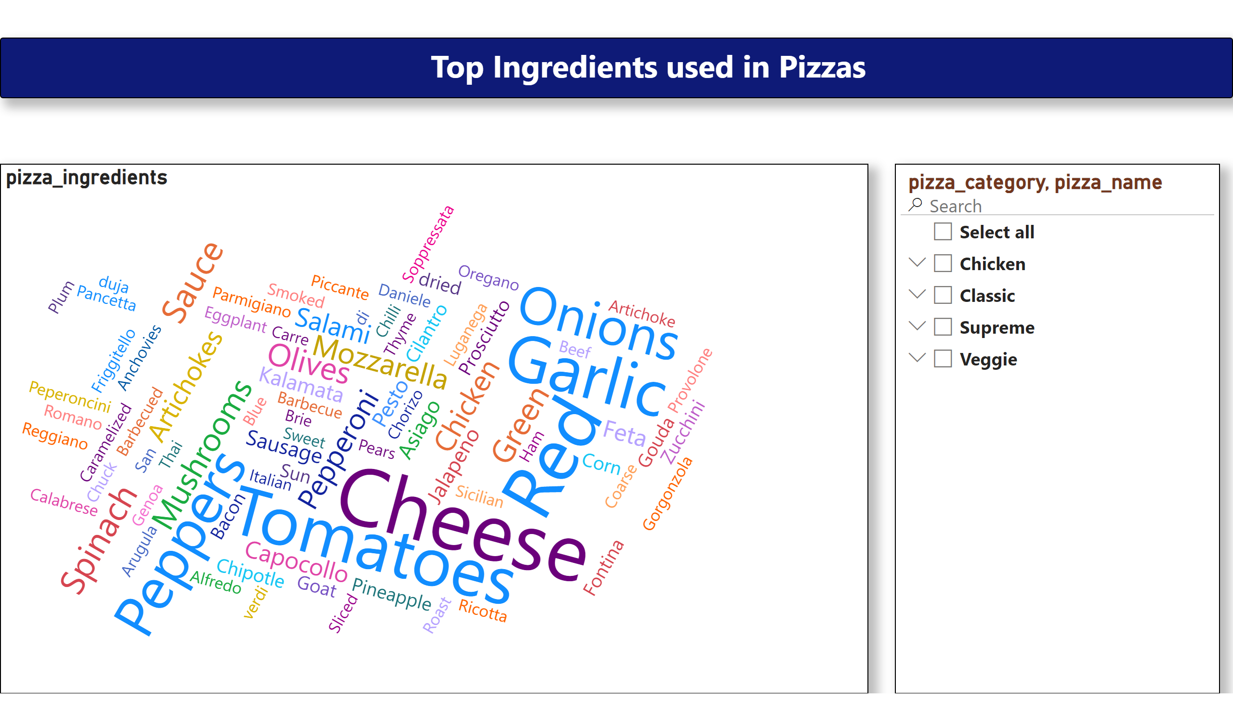
Top Ingredients Used in Pizzas
Notes:
textbox
No alt text provided
slicer
No alt text provided
WordCloud1447959067750
No alt text provided

Slide 11
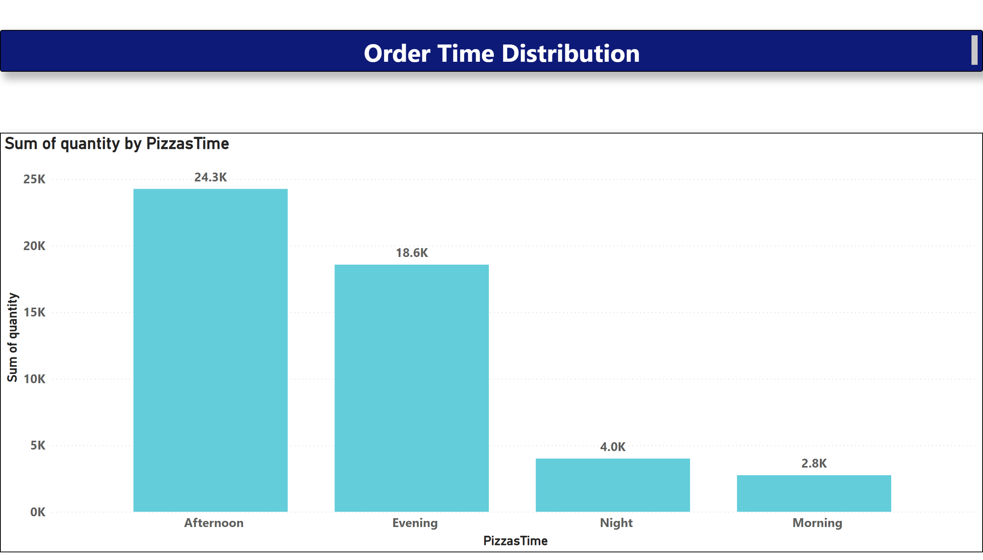
Order Time Distribution
Notes:
textbox
No alt text provided
columnChart
No alt text provided

Slide 12
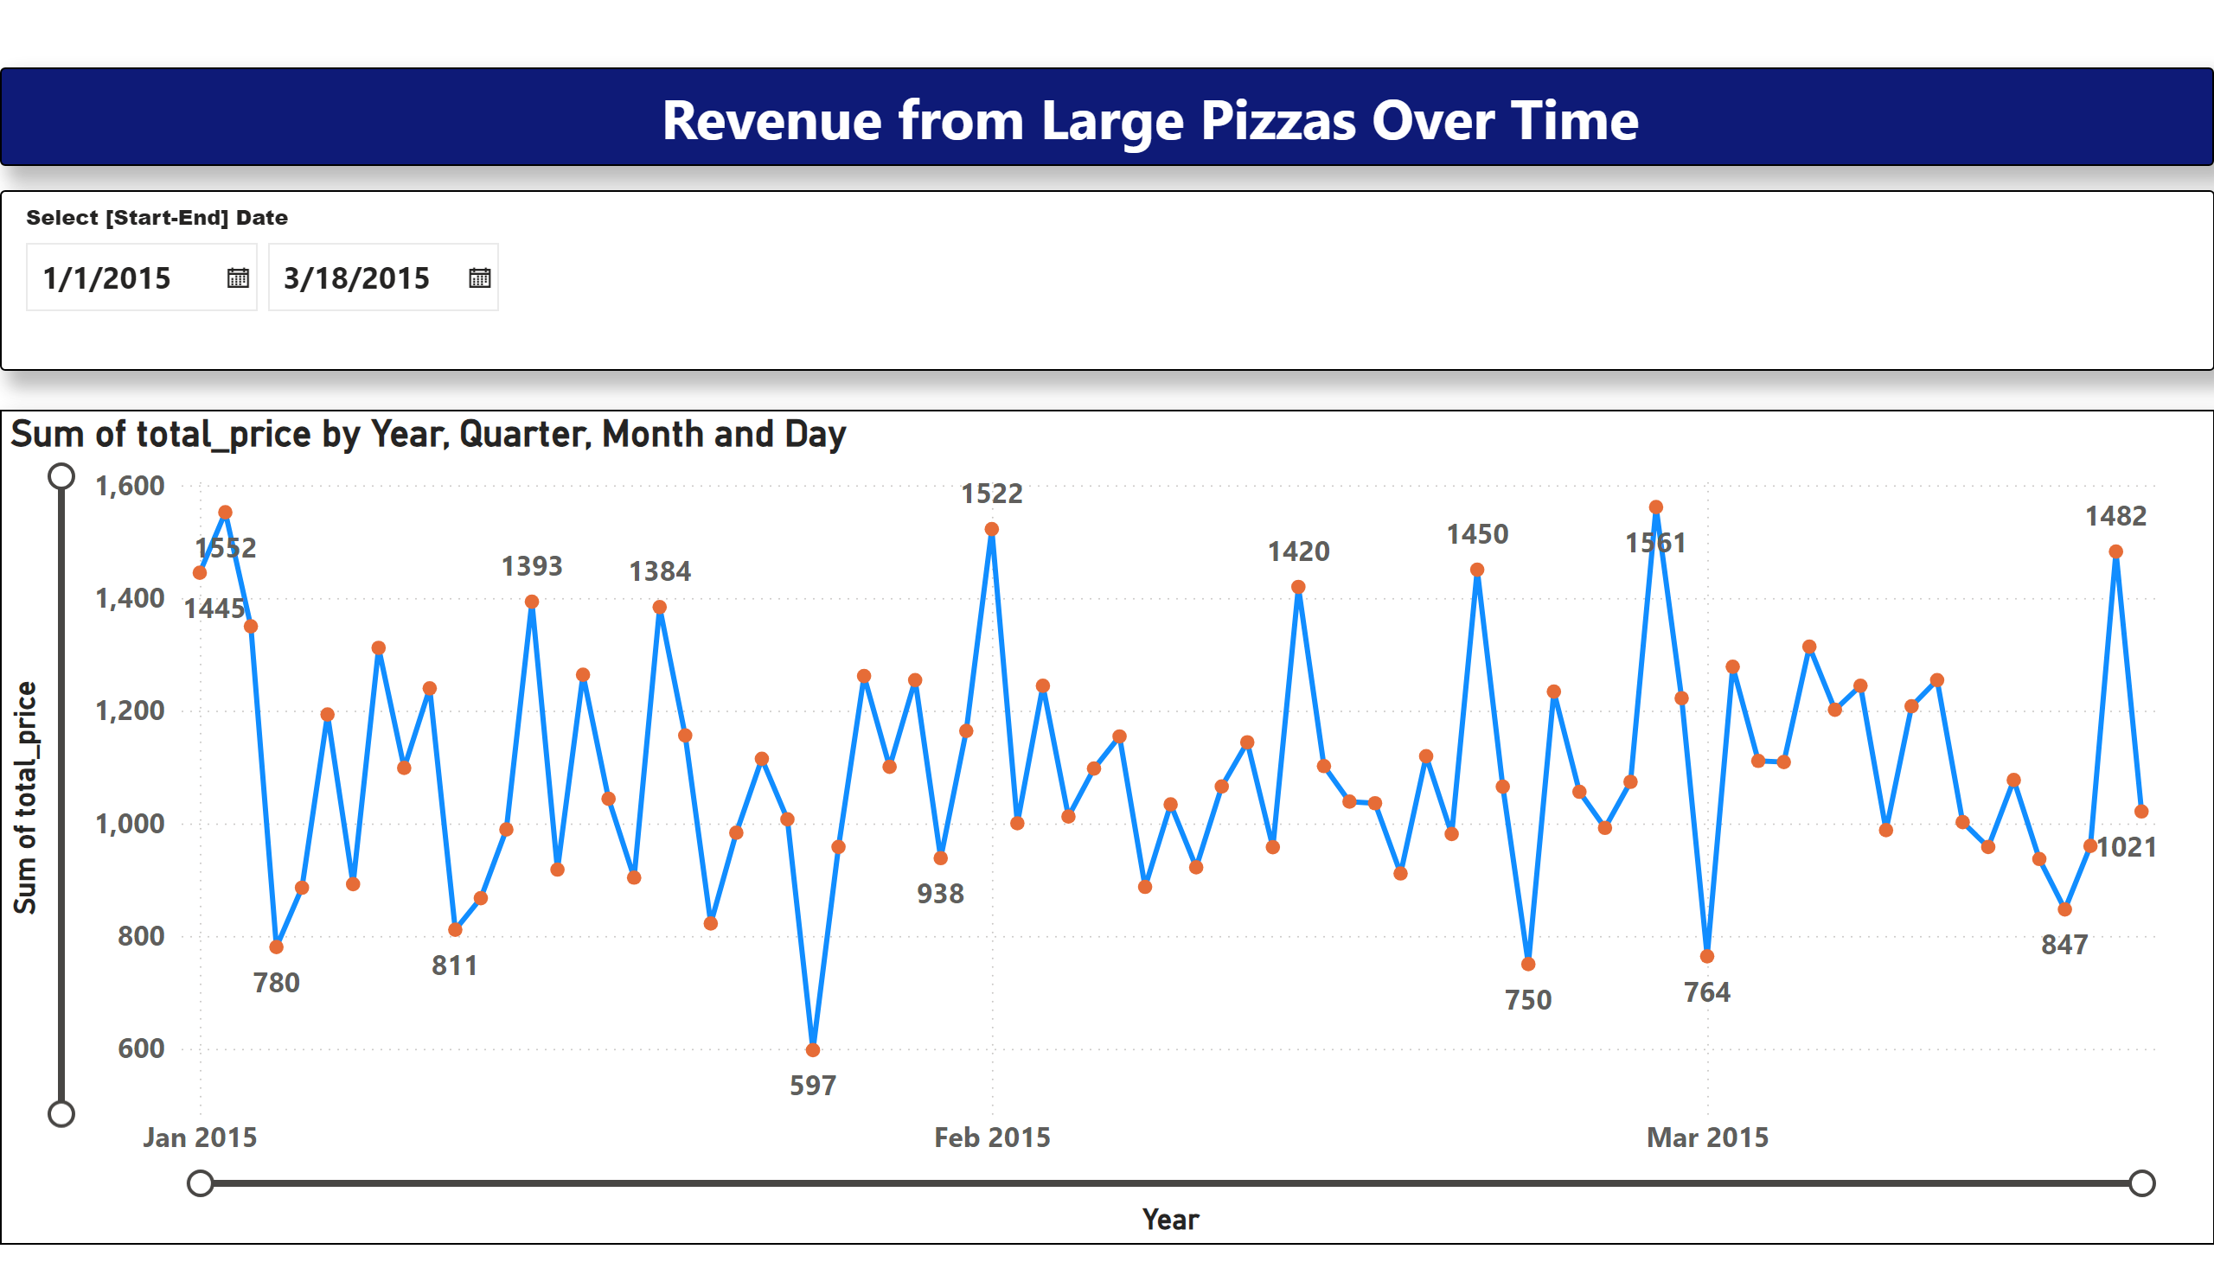
Revenue from Large Pizzas Over Time
Notes:
textbox
No alt text provided
lineChart
No alt text provided
slicer
No alt text provided

Slide 13
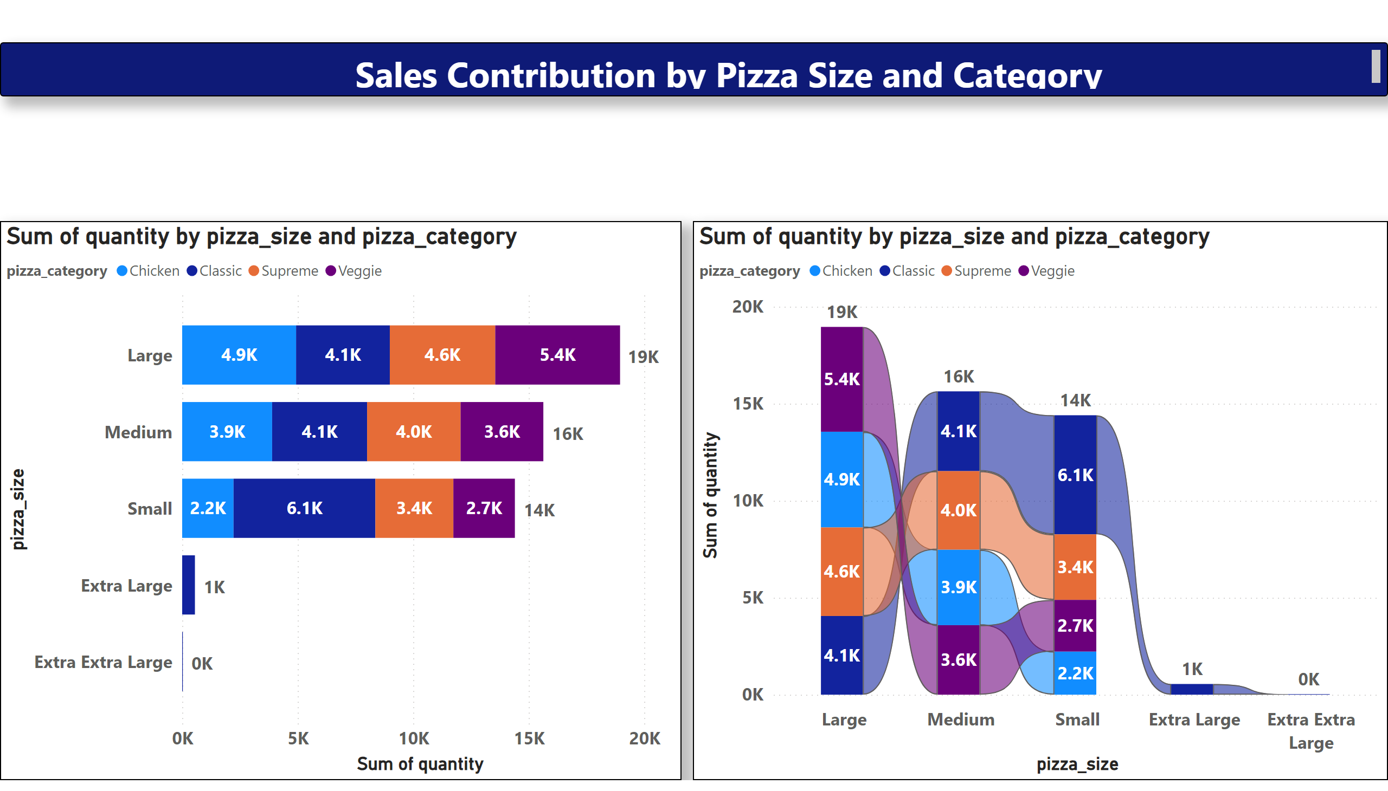
Sales Contribution by Pizza Size and Category
Notes:
textbox
No alt text provided
barChart
No alt text provided
ribbonChart
No alt text provided

Slide 14
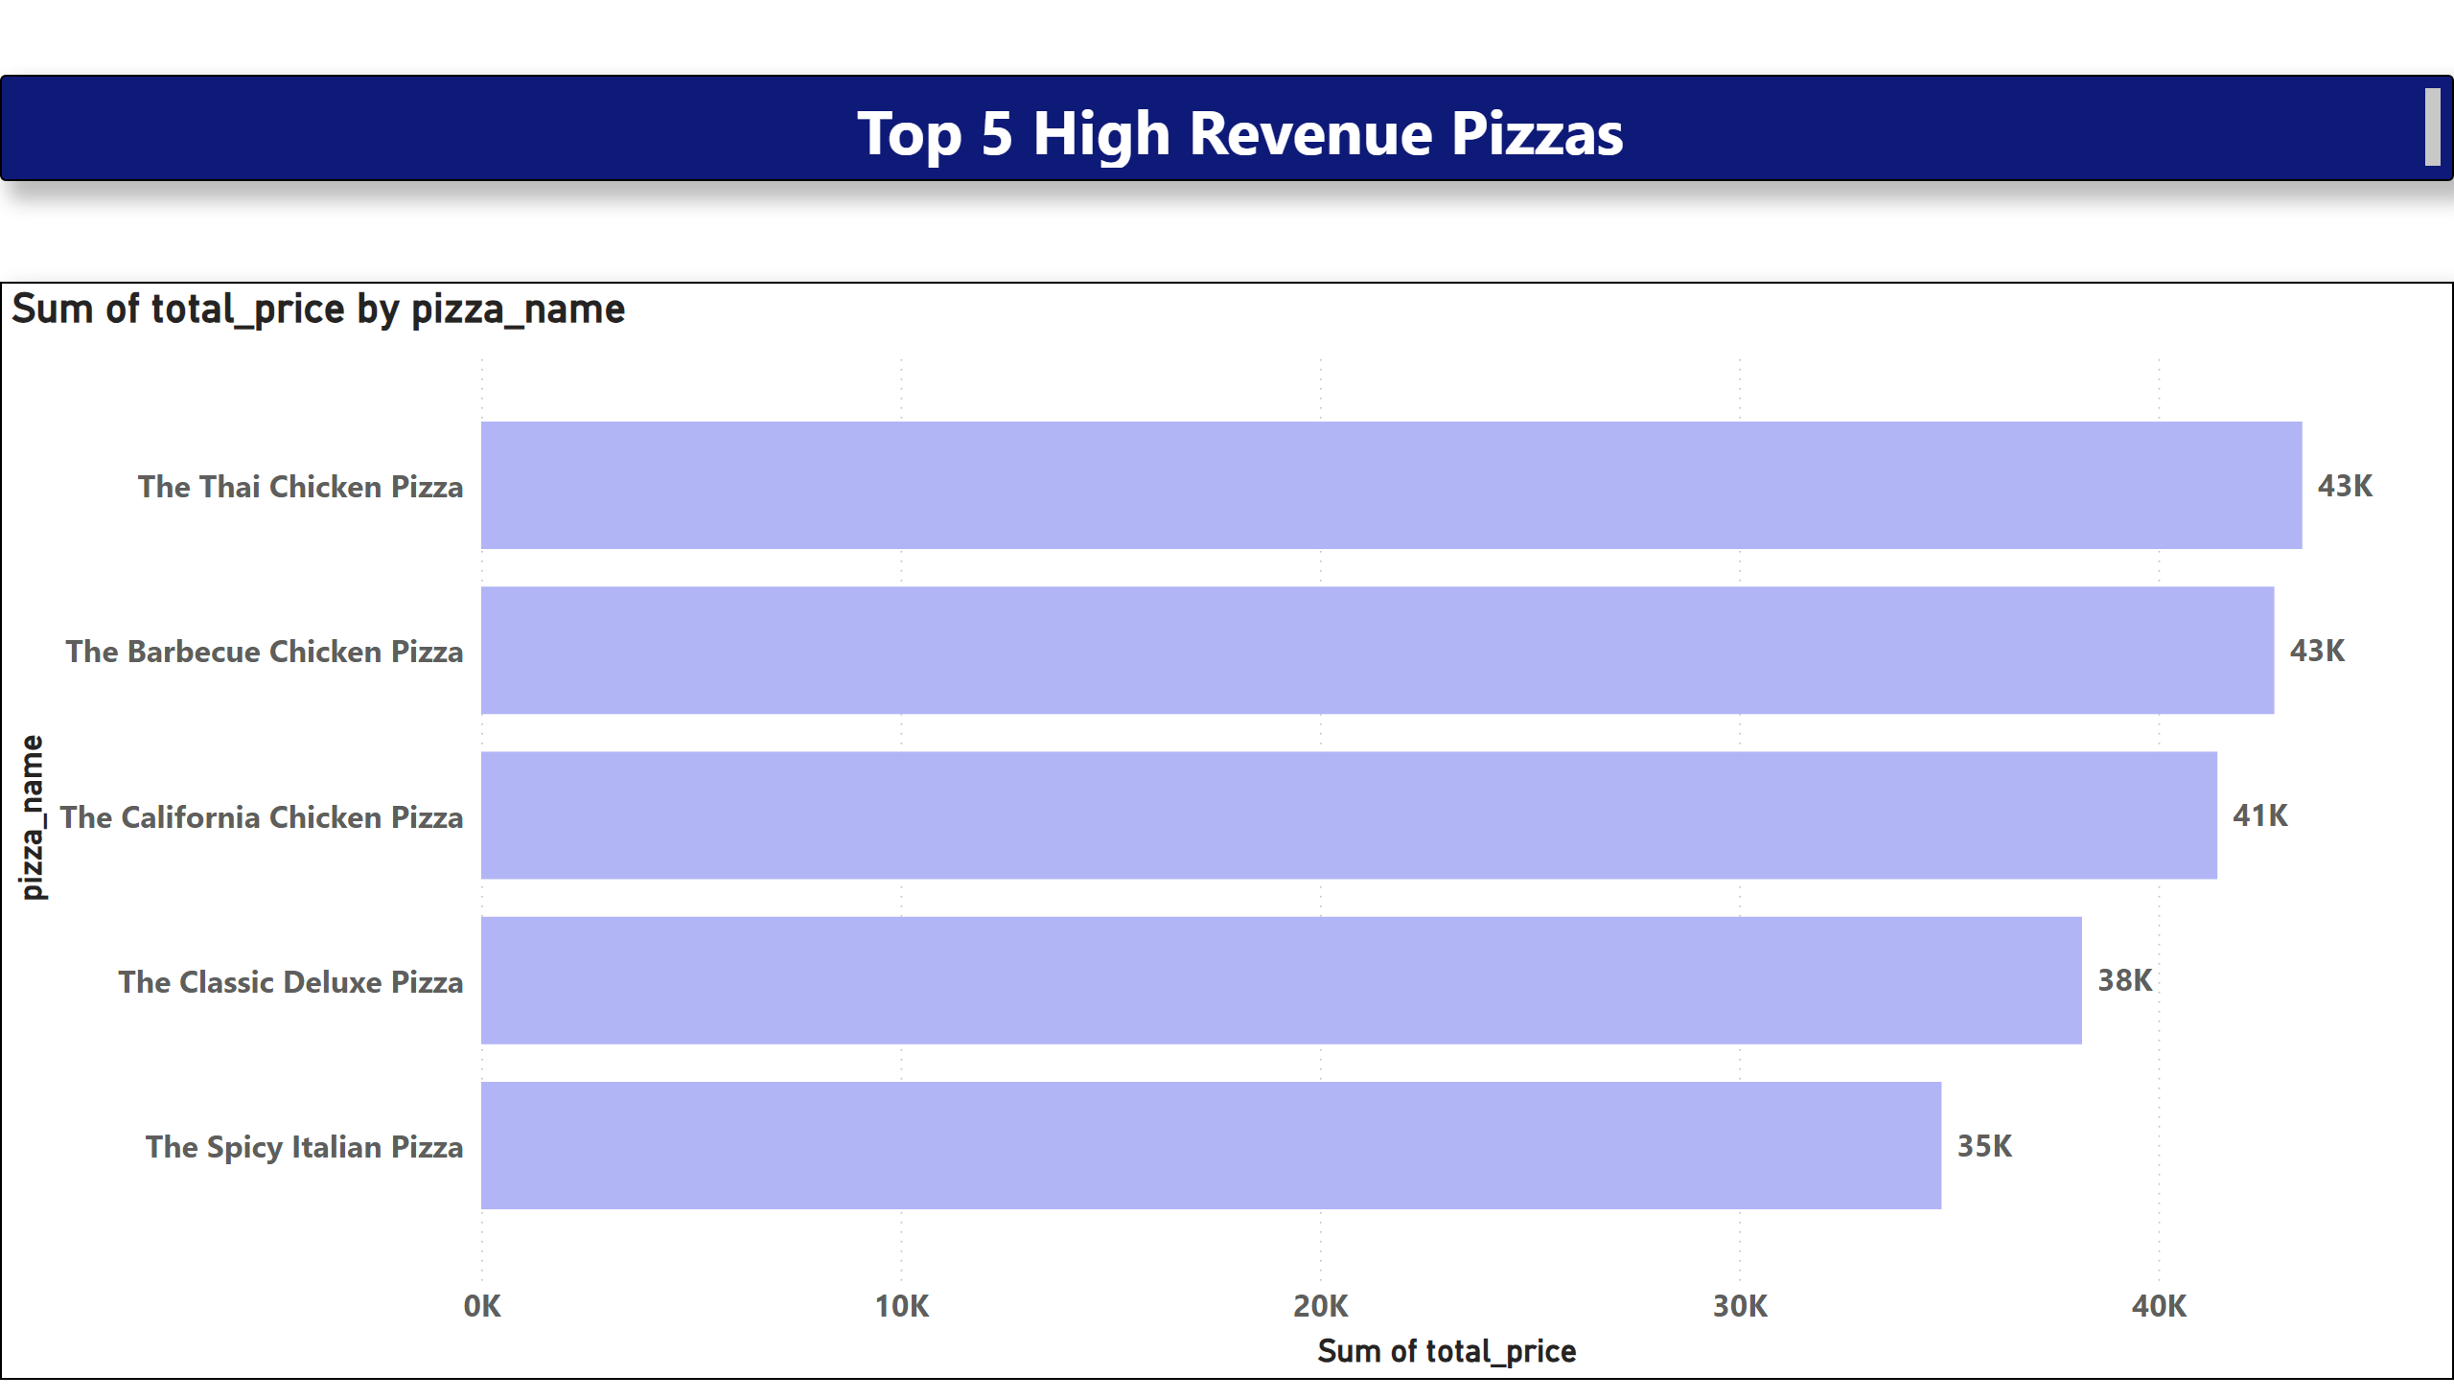
Top 5 High Revenue Pizzas
Notes:
textbox
No alt text provided
barChart
No alt text provided

Slide 15
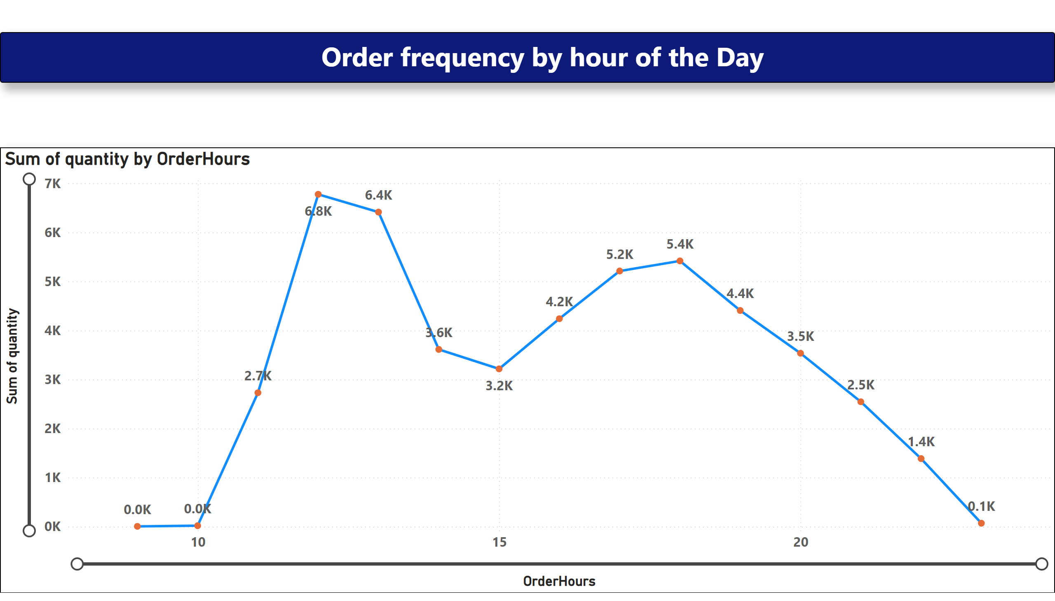
Order frequency by hour of the Day
Notes:
textbox
No alt text provided
lineChart
No alt text provided

Slide 16
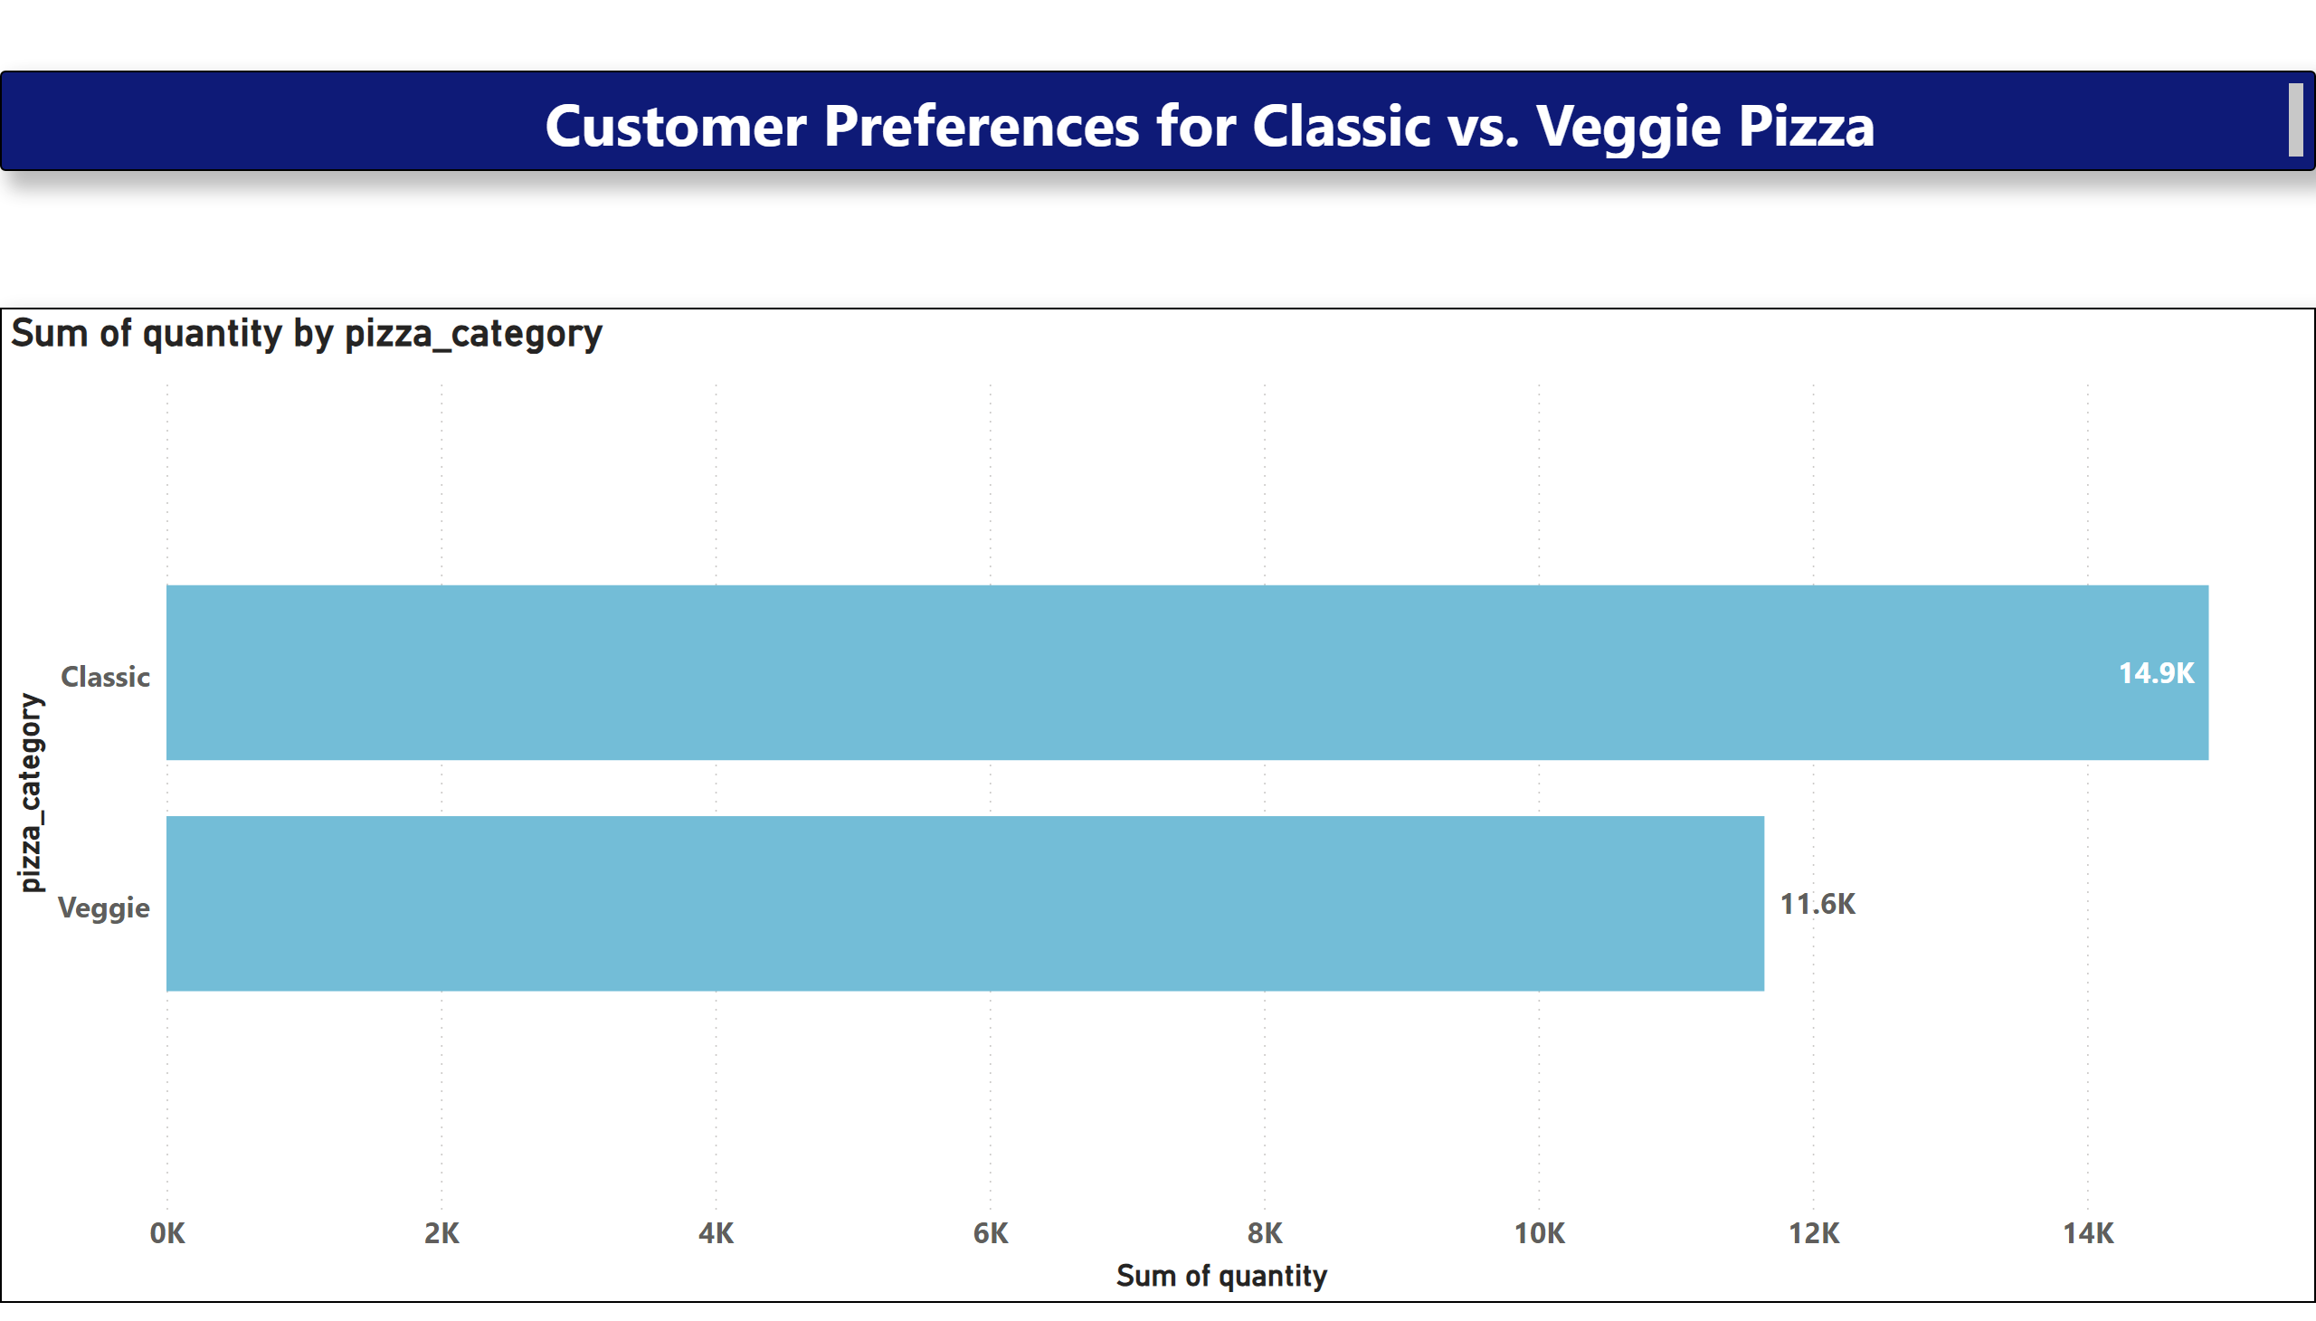
Customer Preferences for Classic vs. Veggie Pizza
Notes:
textbox
No alt text provided
barChart
No alt text provided

Slide 17
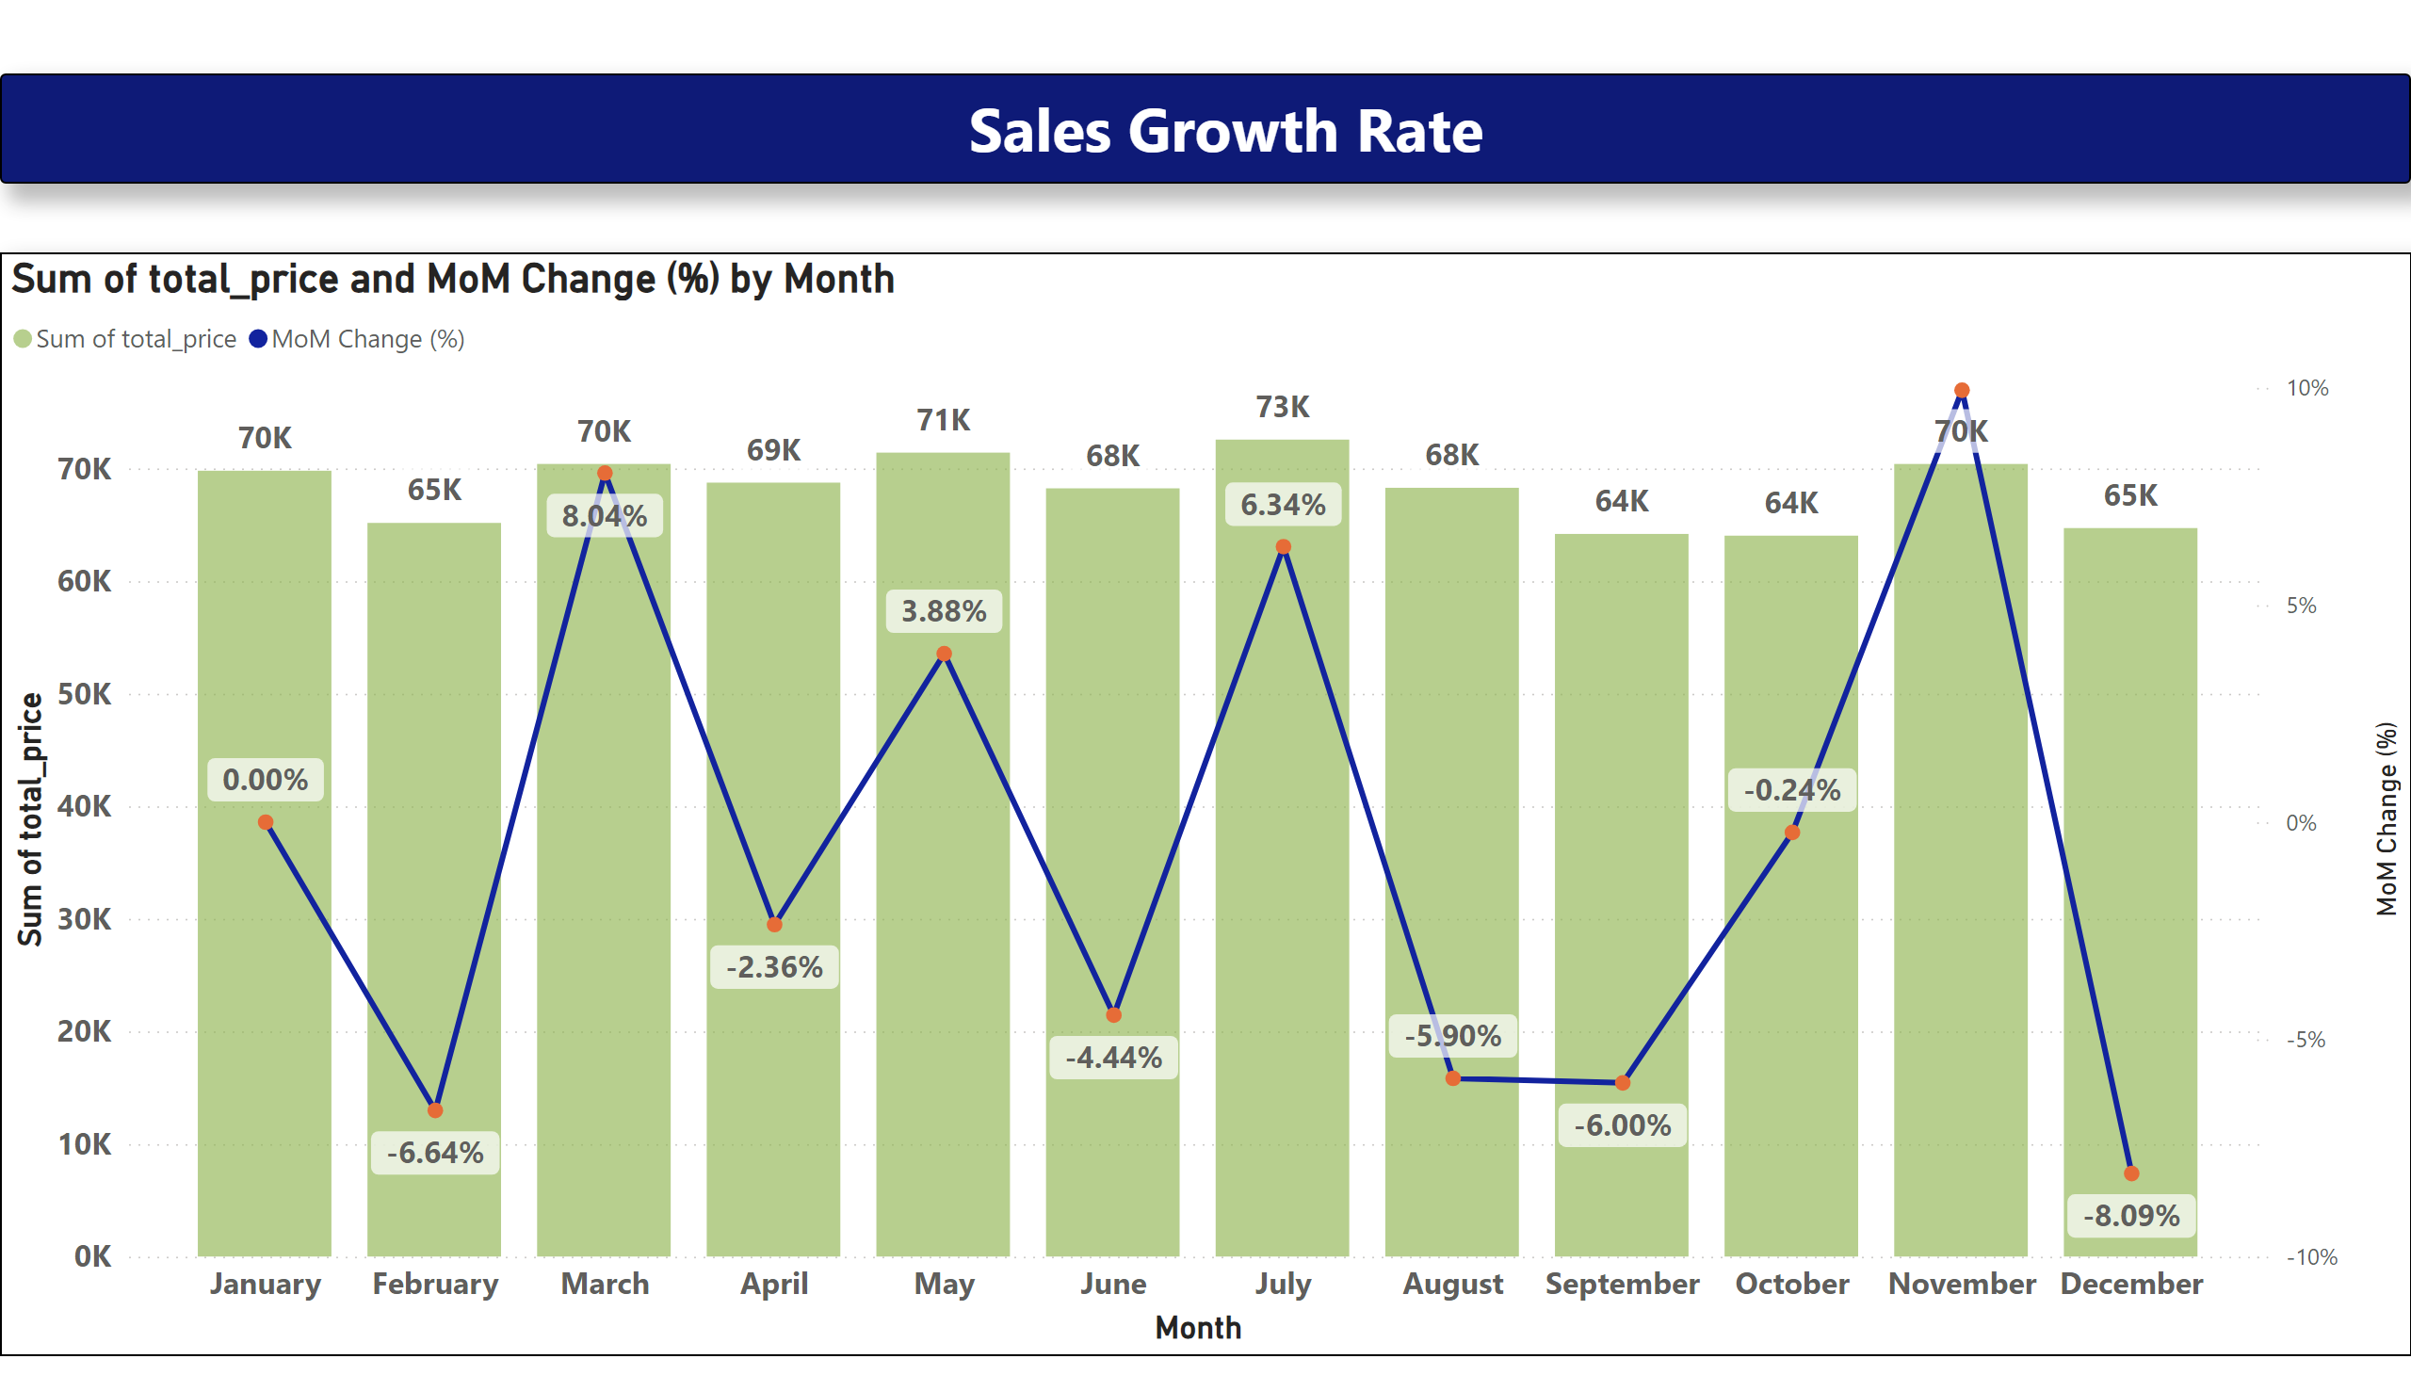
Sales Growth Rate
Notes:
textbox
No alt text provided
lineStackedColumnComboChart
No alt text provided

Slide 18
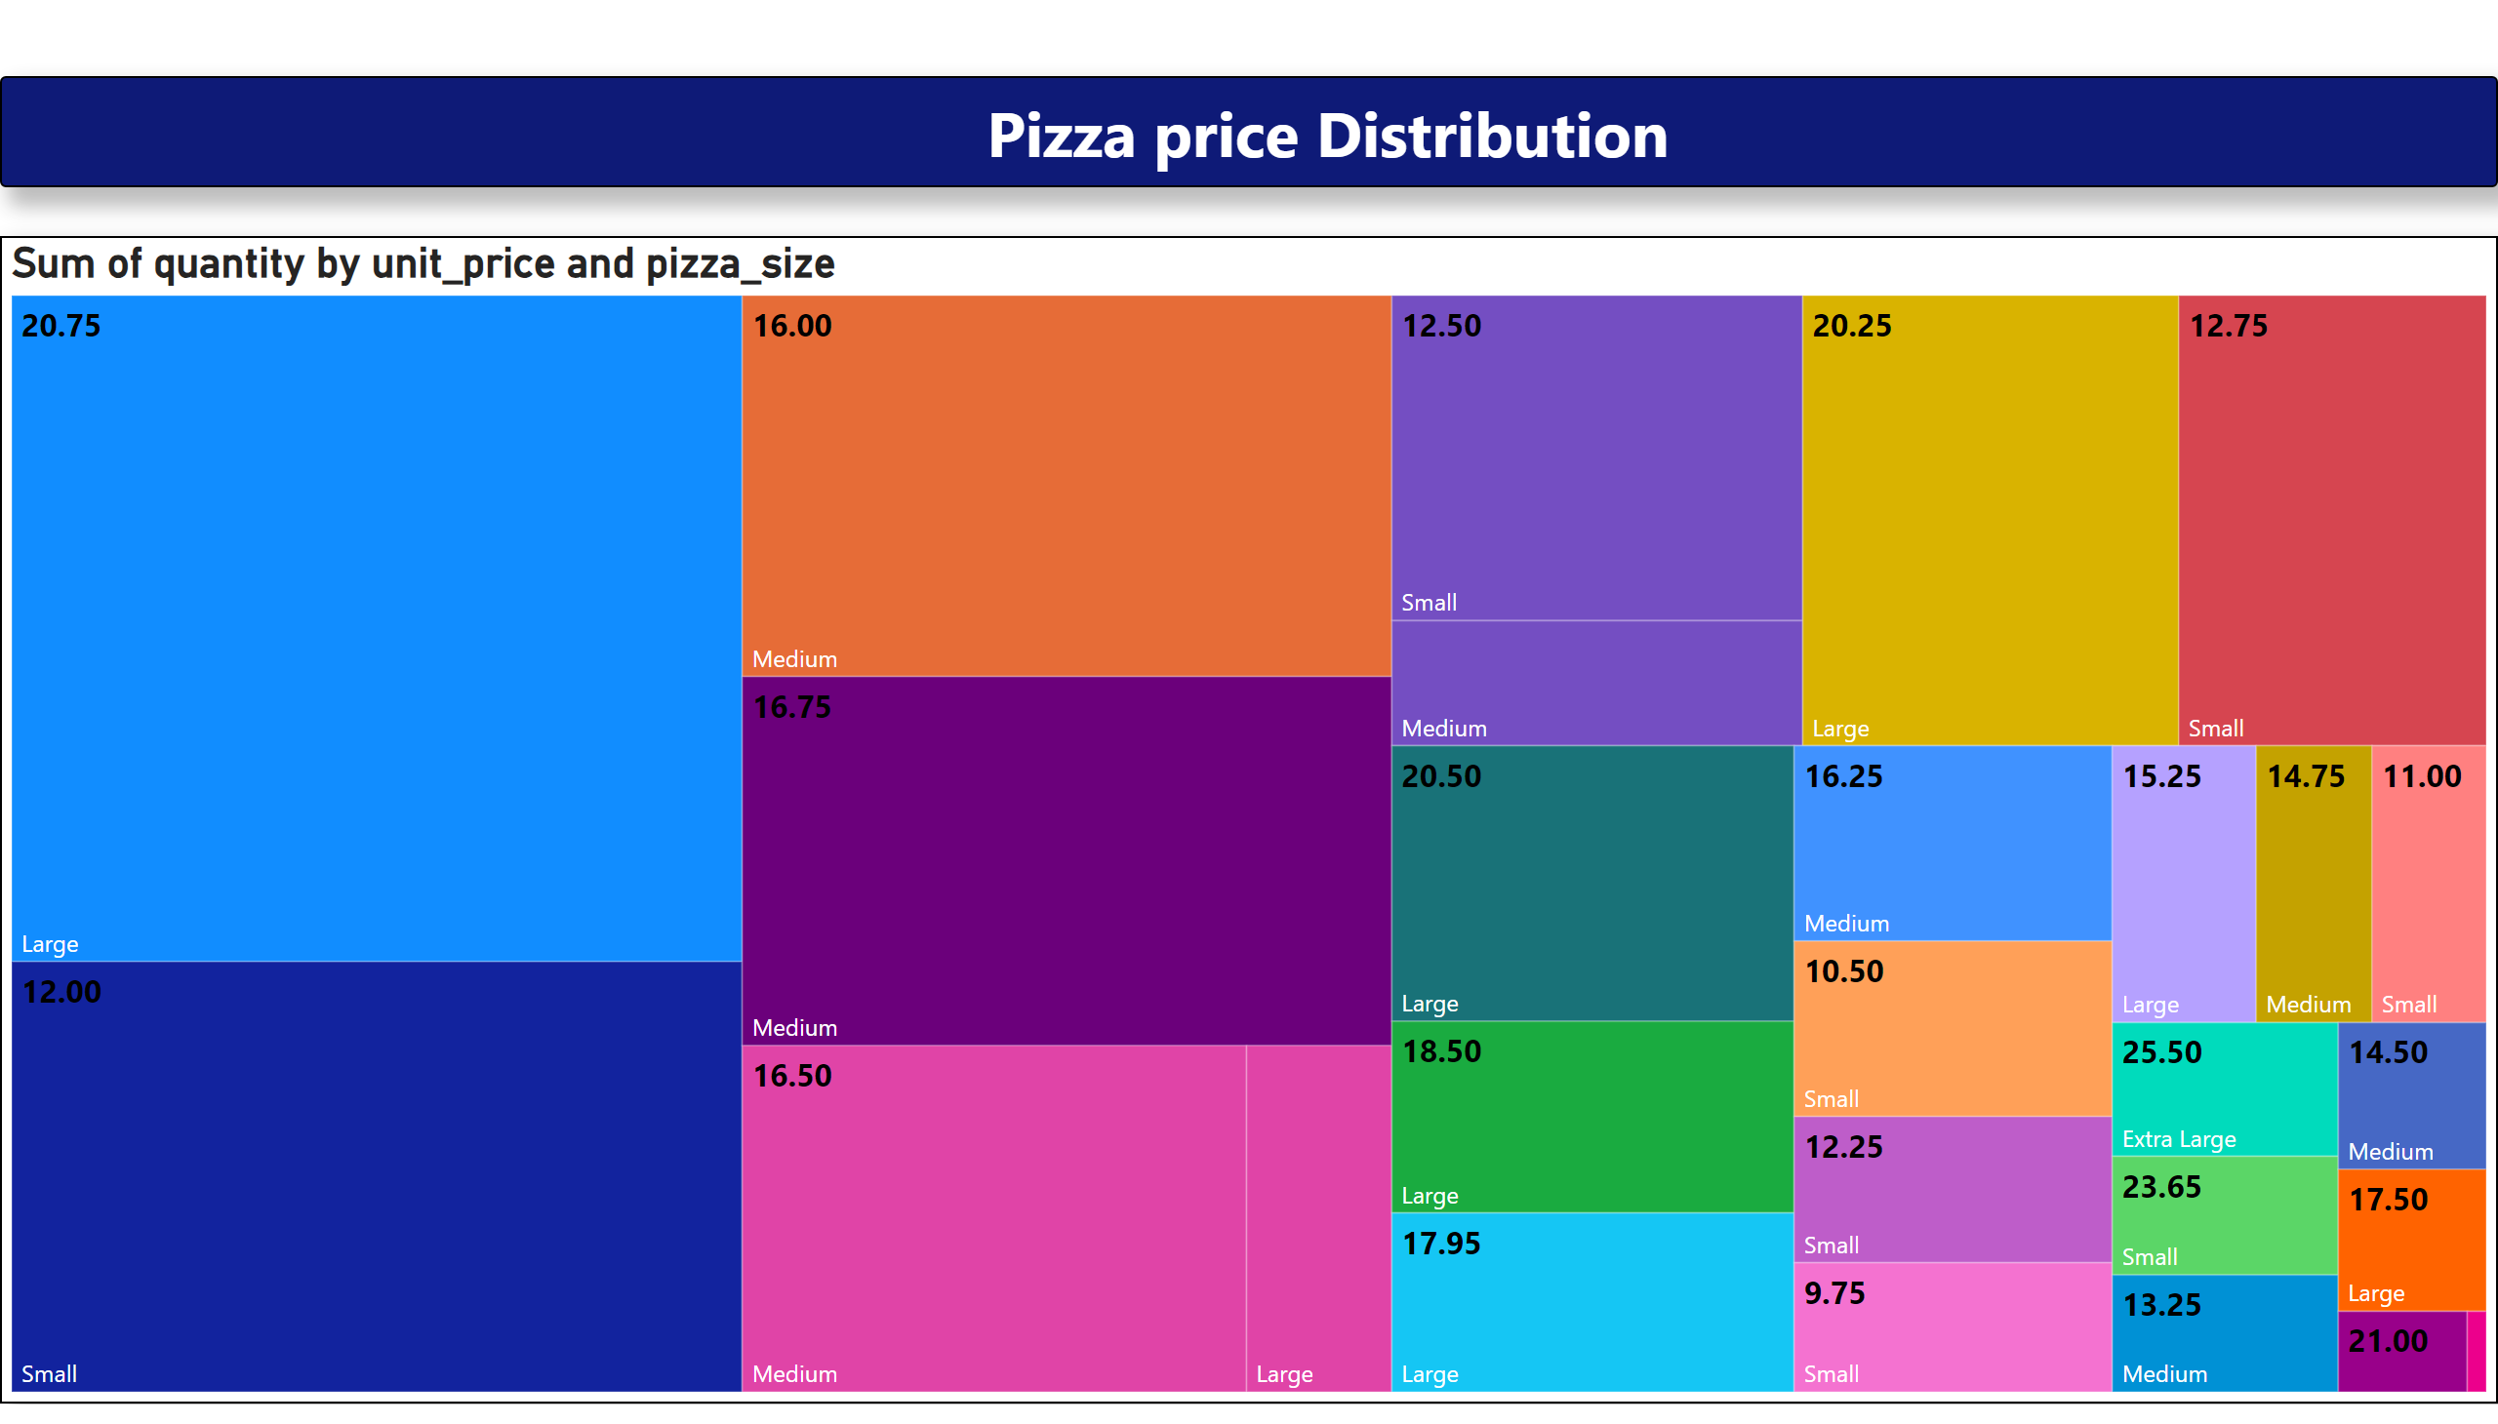
Pizza price Distribution(Tree Map)
Notes:
textbox
No alt text provided
treemap
No alt text provided

Slide 19
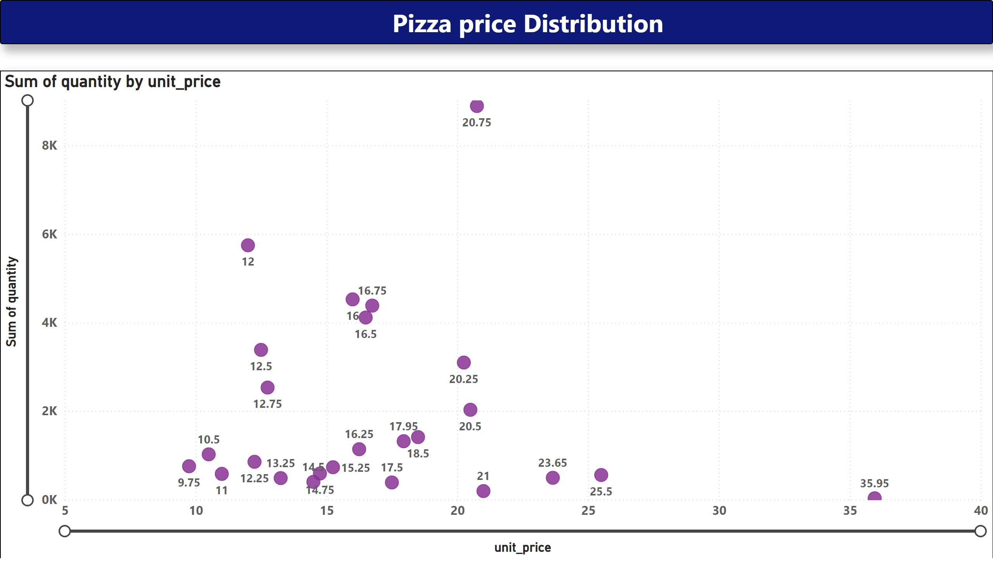
Pizza price Distribution(Scatter Map))
Notes:
textbox
No alt text provided
scatterChart
No alt text provided

Slide 20
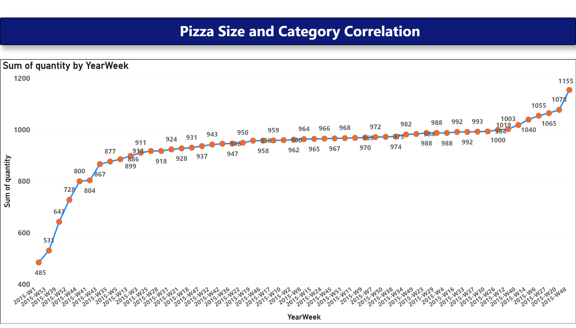
Pizza Size and Category Correlation
Notes:
textbox
No alt text provided
lineChart
No alt text provided

Slide 21
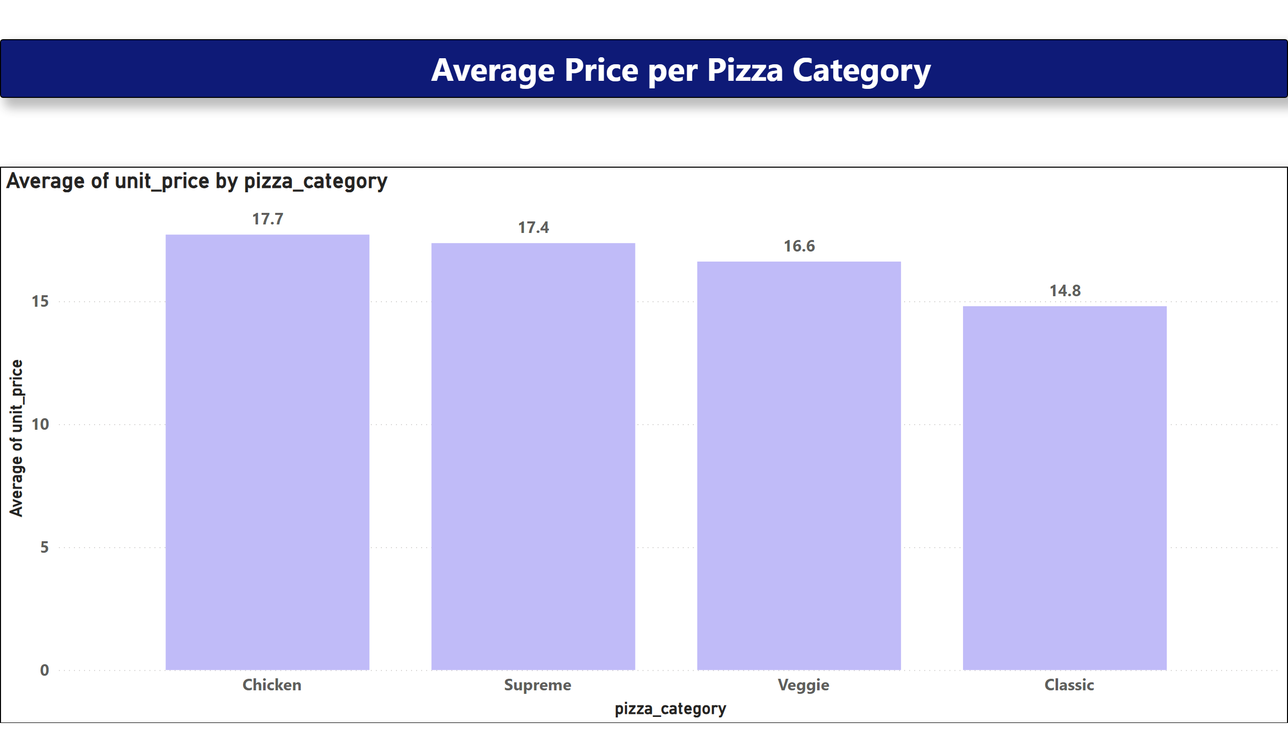
Average Price per Pizza Category
Notes:
textbox
No alt text provided
columnChart
No alt text provided

Slide 22
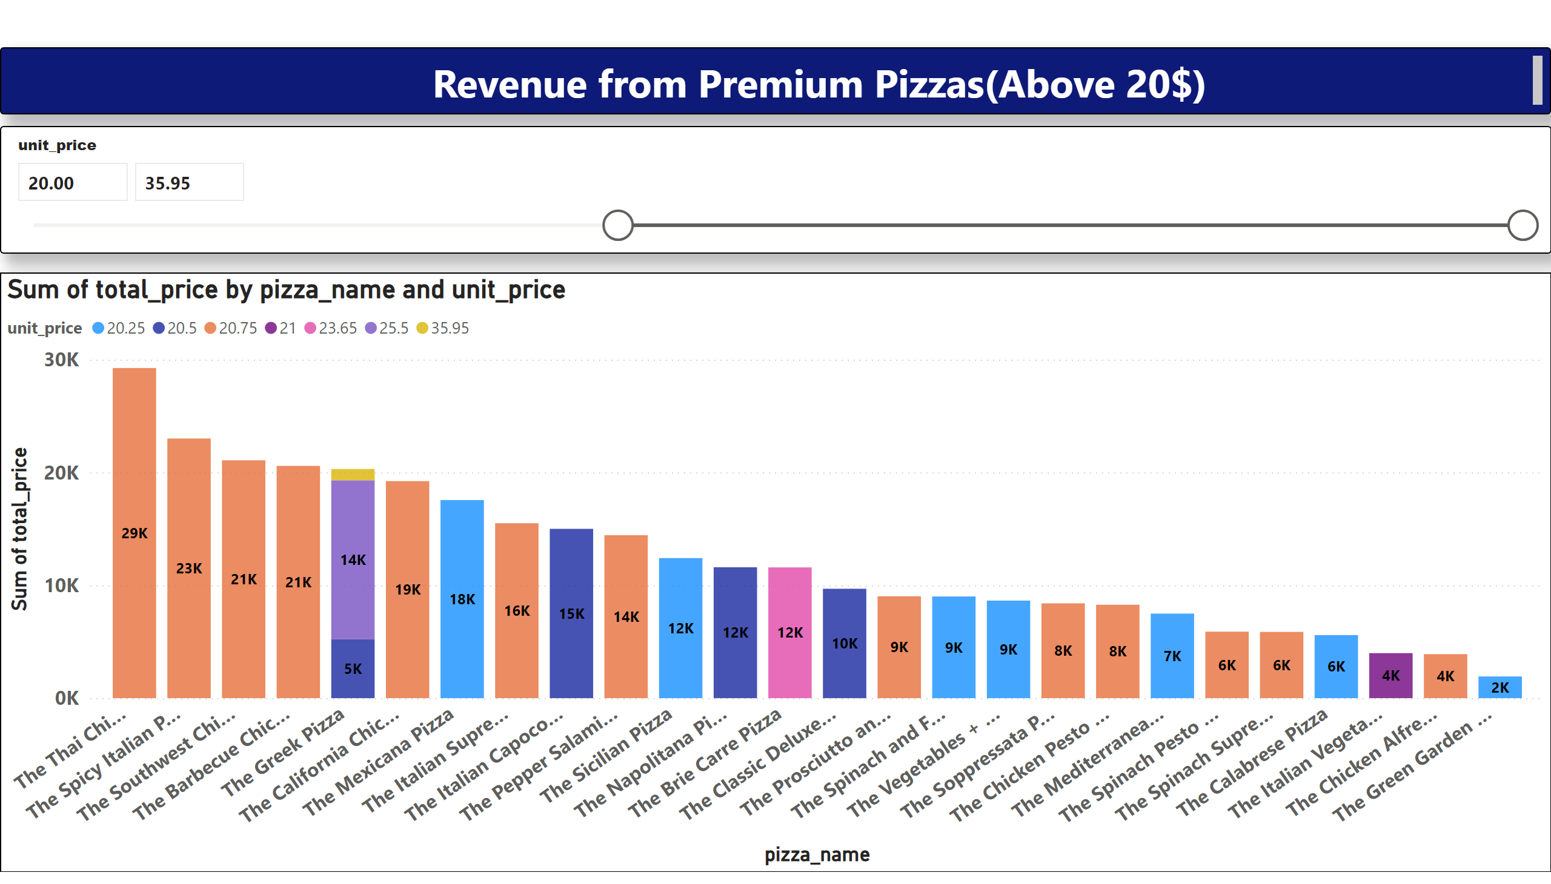
Revenue from Premium Pizzas(Above 20$)
Notes:
textbox
No alt text provided
columnChart
No alt text provided
slicer
No alt text provided

Slide 23
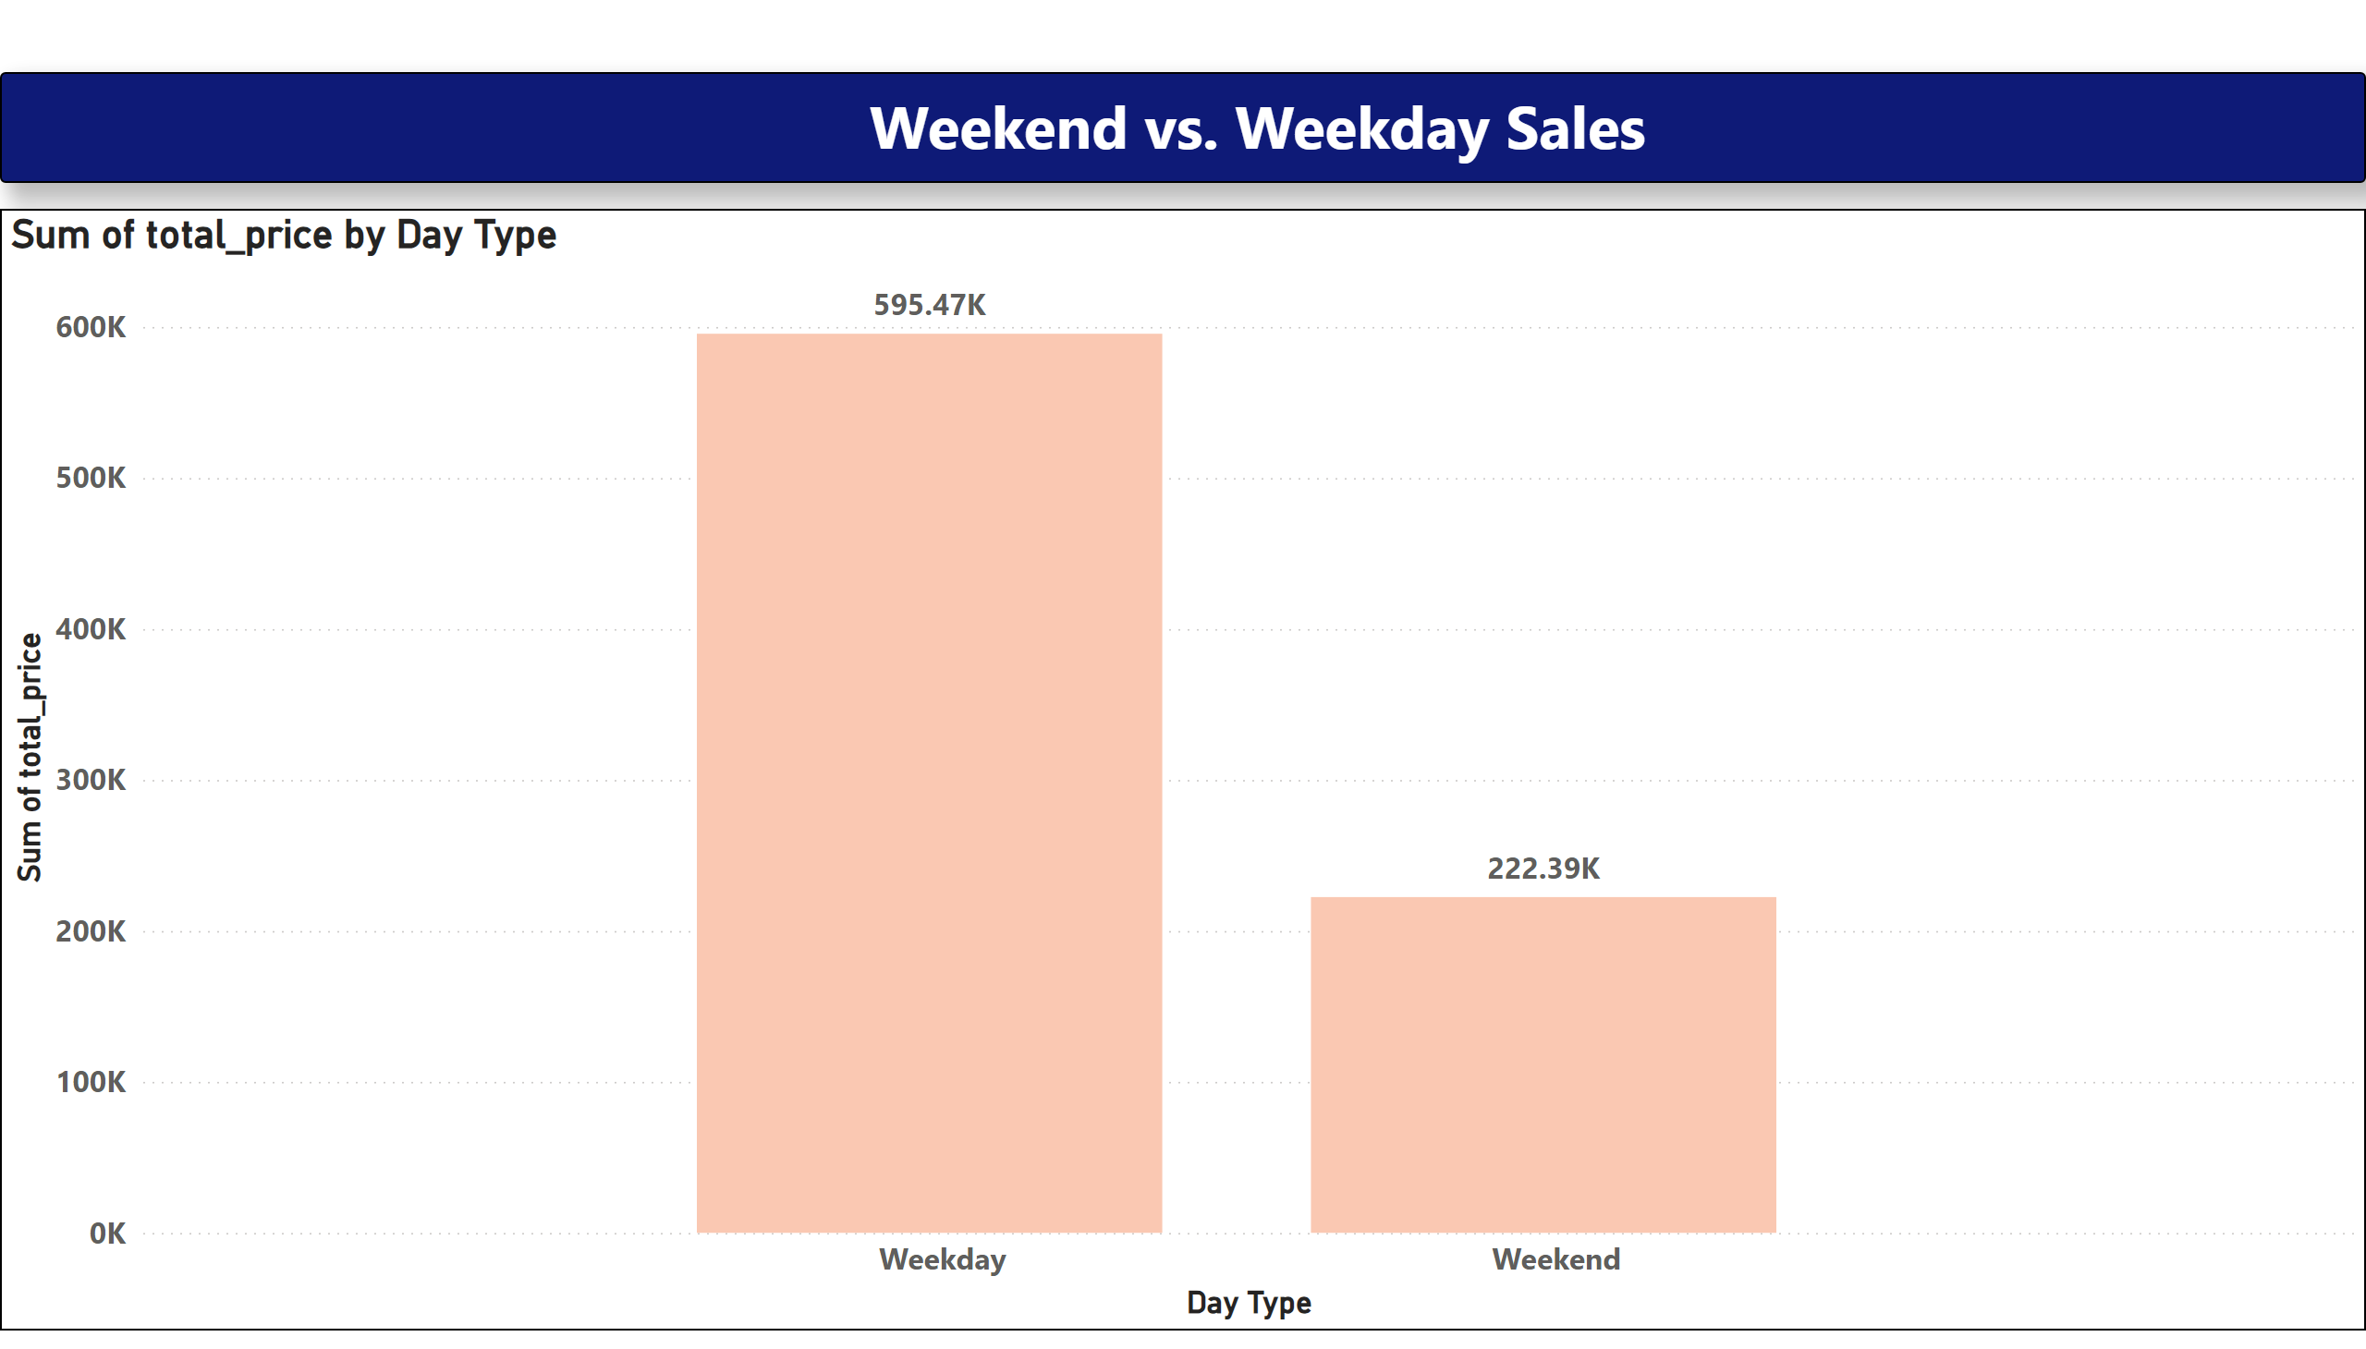
Weekend vs. Weekday Sales
Notes:
textbox
No alt text provided
columnChart
No alt text provided

